Slide 1
Yearly Analytics Report
August 2023
Retail Analytics

Slide 3
Table of Contents
Executive Summary ………………………………………….......................................................................................Slide 4
Task 1 Agenda……………………………………………………………………………………………………………………………………………….Slide 5
Task 1 Summary…………………………………………………………………………………………………………………………………………...Slide 6
Task 1 Analysis……………………………………………………………………………………………………………………………………….......Slide 7
Task 1 Data Visualisation…………………………………………………………………………………………………………………………….Slide 8
Task 2 Agenda……………………………………………………………………………………………………………………………………………….Slide 9
Task 2 Summary………………………………………………………………………………………………………………………………………….Slide 10
Task 2 Analysis……………………………………………………………………………………………………………………………………………Slide 11
Task 2 Data Visualisation…………………………………………………………………………………………………………………………..Slide 12
Recommendations……………………………………………………………………………………………………………………………………..Slide 13

Slide 4
Executive summary
01
Task 1
We were able to extract and analyse our data for valuable insights. The primary product categories were ‘Chips’ so the data analyst team concluded that it would be appropriate to remove any products which don’t conform to that category. Products were categorised based on their packing size, their brand, the customer age demographic and the customer category i.e. Premium, Budget etc. Hence, we were able to identify the company's best-selling chips brands and the high-earner groups amongst our customers which ensure more profits than others.
02
Task 2
In our second task, our primary focus was to analyse that what effect did the different stores had on each other. How were their sales inter-connected and whether there was an influence on the sales based on the distance between the stores. To test our theory, we selected three separate trial stores. We observed the sales and the customers that the trail stores had in comparison to other stores.

Slide 5
01
Category

Slide 6
Overview:
Prioritizing Customer Segments: Notably, the customer segments that demonstrated the highest total sales were Older Families and Retirees, with a particular emphasis on those identified as Budget customers. As a result, it is recommended to concentrate promotional efforts and advertising strategies on these segments.
Enhancing Young Singles/Couples Engagement: The Young Singles/Couples segment displayed the lowest average unit price and average units per customer in comparison to other segments. This signifies a potential avenue for elevating purchase frequency and basket size through precisely targeted offers.
Unlocking Potential of Mainstream Midage/Young Customers: A statistically significant variance in average transaction value emerged through t-tests, isolating Mainstream Midage/Young customers from other segments. This divergence creates an opening to convert more of these mainstream customers into premium customers through tailored promotional initiatives.
Leveraging Consistent Brand Appeal: While the preferred chip brands varied across different customer segments, Smiths and Kettle consistently remained at the forefront. Strengthening marketing partnerships and optimizing in-store merchandising efforts with these brands stands to bolster overall sales.
December showed a spike in transactions in the weeks leading up to Christmas, presenting a promotional opportunity around holiday entertaining and gift-giving.
In summary, the key focus areas based on the analysis are:
Driving purchase frequency for Young Singles/Couples
Increasing basket size for mainstream Midage/Young customers
Capitalizing on seasonality trends around holidays
Partnering with leading brands like Smiths and Kettle

Slide 7
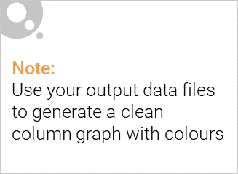
Based on the analysis, there are some interesting insights on how affluence impacts buying behavior in the chip category:
Premium customers in the Older Families, Retirees, and Midage Singles/Couples segments had the highest average price per unit. This indicates more affluent consumers are willing to pay a premium for perceived quality.
Premium Older Families had the highest average units purchased per customer. More affluent families with older children may buy chips for snacking and school lunches.
Mainstream Young Singles/Couples had a lower average price per unit than the premium segment. Less affluent younger consumers may be more price conscious.
Popular brands varied between premium and mainstream/budget segments. Premium customers favored more specialty brands like Kettle and Red Rock Deli, while mainstream segments preferred value brands like Smith's.
Total sales skewed higher for budget segments, but average transaction values were lower. Less affluent households may buy chips more frequently but in smaller quantities per trip.
Overall, the analysis shows clear patterns between affluence, price sensitivity, purchase frequency, and brand preference in the chip category.

Slide 8
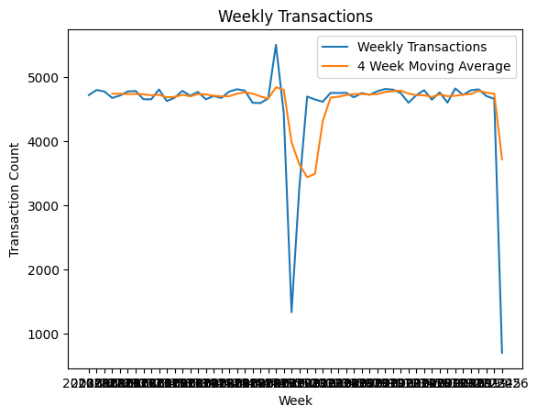
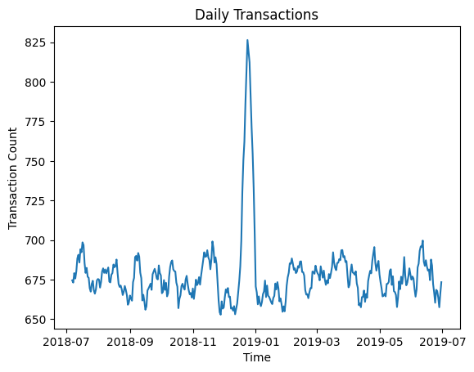
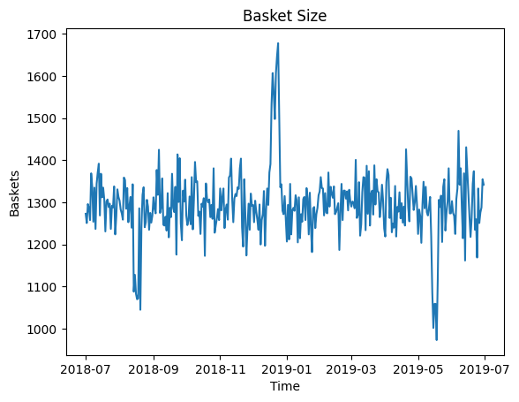
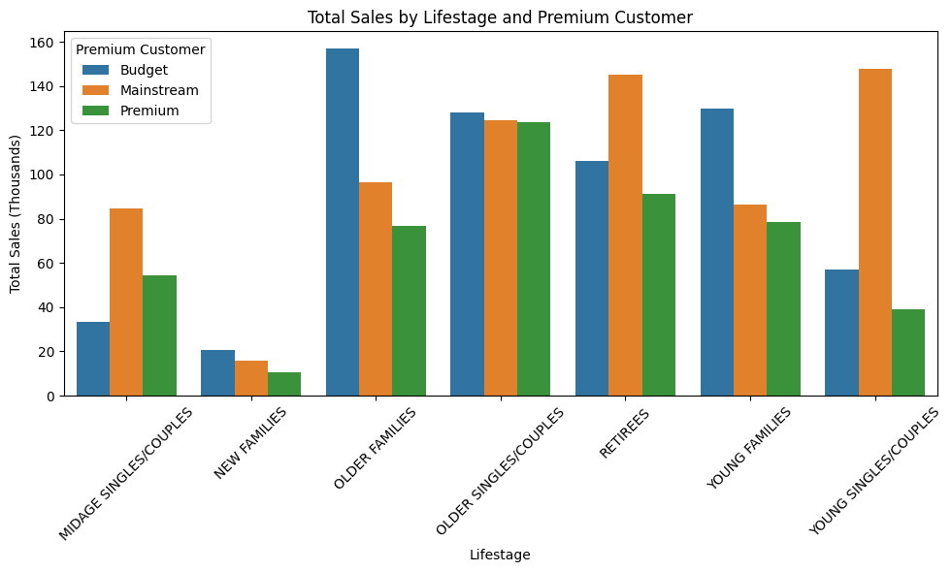
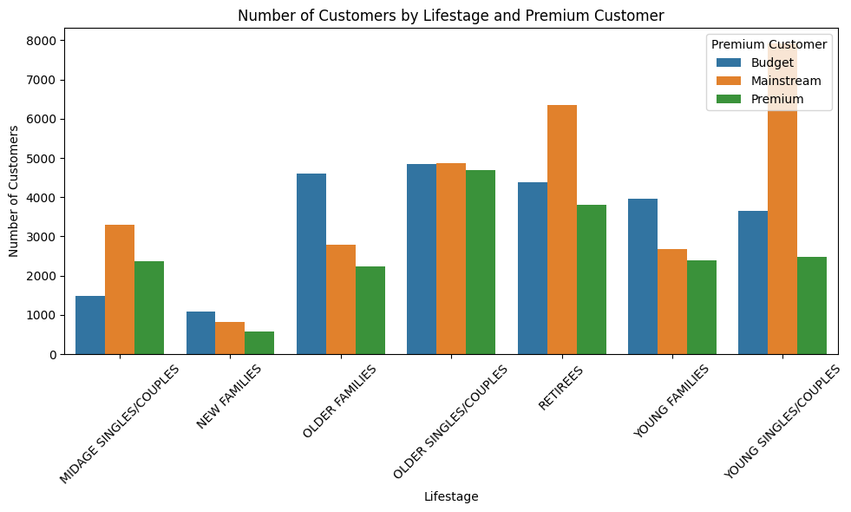
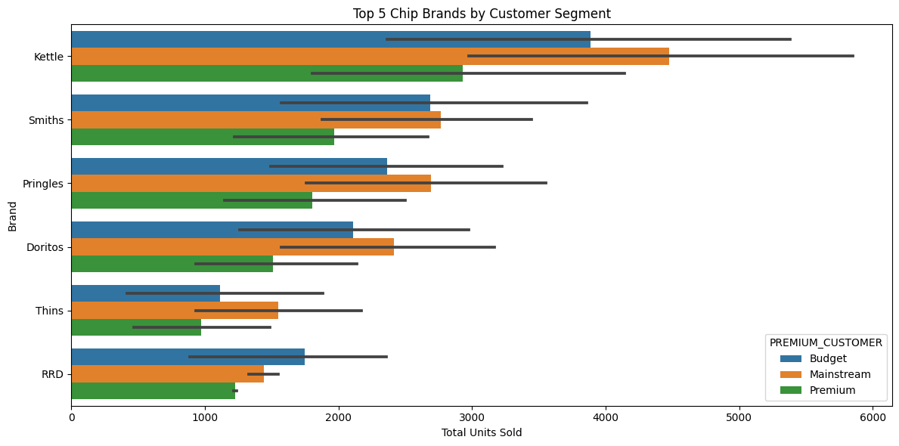

Slide 9
02
Trial store performance

Slide 10
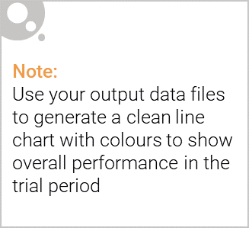
Based on the analysis performed in the attached notebook, the key differences between using a control store vs other stores for comparison are:
Control Store: A specific store is chosen that closely matches the trial store in pre-trial sales, number of customers, trends over time etc. This provides a one-to-one comparison for the trial period.
Other Stores: All stores except the trial store are grouped together into an "other stores" category. This gives an overall average trend for comparison.
The advantages of using a control store are:
More direct comparison as trends are matched pre-trial. Any lift can be more directly attributed to the trial.
Removes variability/noise from using all stores. Focus is on the matched pair.
Can account for external factors like seasonality that would affect both stores.
The advantages of using other stores:
Provides an overall average baseline not dependent on matching to a specific store.
More data points for pre-trial statistics and trends.
If trial store is an outlier, comparing to all others normalizes for this.
So, in summary, a control store allows a more direct comparison controlling for external factors, while other stores provides a more general baseline. The analysis uses both to provide different perspectives on the trial's impact. Selecting an appropriate control store is key to getting the most valid results.

Slide 11
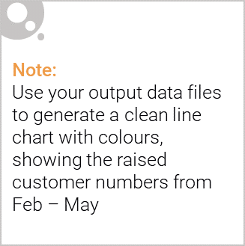
Based on the analysis in the attached notebook, here is an assessment of the trial performance for each store:
Trial Store 77:
Total sales were significantly higher than the control store in all 3 trial months.
Number of customers was significantly higher in 2 of 3 months.
The trial looks very successful based on consistently exceeding the control store and 95% confidence interval.
Trial Store 86:
Total sales were higher than control in 2 months but lower in 1 month.
Number of customers was not significantly higher than control in any month.
The trial does not appear very successful based on inconsistent sales lift and no customer lift.
Trial Store 88:
Total sales exceeded control and 95% CI in all 3 months.
Number of customers was significantly higher in 2 of 3 months.
The trial looks clearly successful based on consistent strong lift versus control.
In summary, Trial Stores 77 and 88 demonstrate a successful trial with significant lift in sales and customers. Trial Store 86 is more ambiguous with inconsistent sales gains and no customer lift, indicating an unsuccessful or poorly implemented trial. Overall, 2 of 3 trial stores showed positive trial results, suggesting the promotional strategy is effective in most cases.

Slide 12
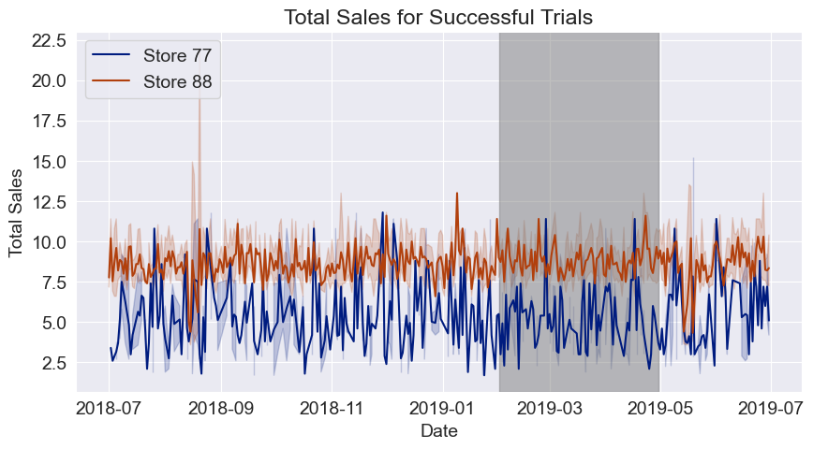
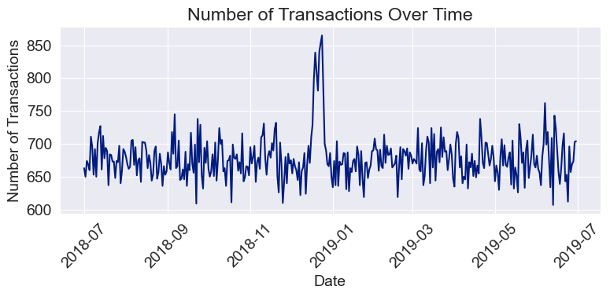
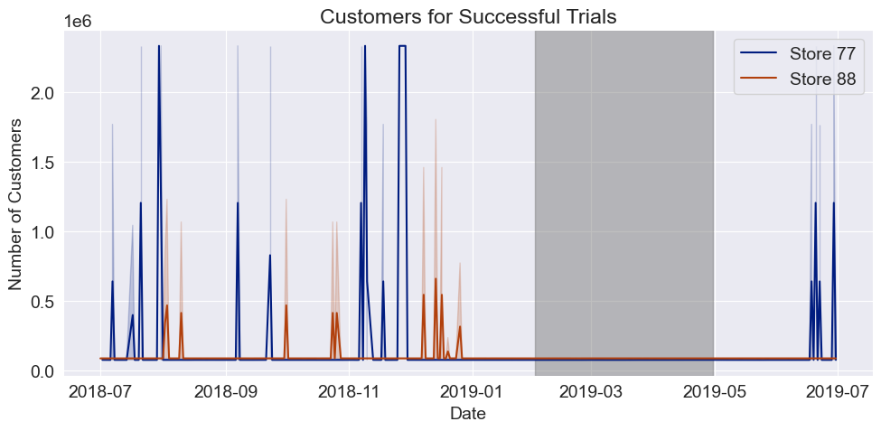

Slide 13
Recommendations:
Based on the data, our team of analysts and strategists have drawn up the following recommendations:
Segmented Marketing Campaigns: Prioritize Older Families and Retirees, particularly Budget customers, for targeted marketing efforts due to their highest sales contribution.
Engage Young Singles/Couples: Address low average price per unit and units per customer in this segment. Introduce special offers to encourage increased purchase frequency and larger basket sizes.
Conversion Strategy for Mainstream Midage/Young: Create customized promotions to convert these customers into premium buyers, leveraging the observed significant difference in average transaction value.
Strategic Brand Partnerships: Collaborate with top brands like Smiths and Kettle for co-branded marketing, cross-promotions, and optimized in-store merchandising.
Holiday Promotions and Packaging: Capitalize on the pre-Christmas transaction surge with seasonal promotions, unique packaging, and limited-time offers.
Innovation in Chip Varieties: Introduce innovative flavors and premium options to cater to affluent consumers' adventurous tastes.
Health-Conscious Offerings: Expand the range of healthier chip options, aligning with wellness trends and health-conscious consumers.
Enhanced In-Store Experience: Collaborate with retailers to optimize chip displays, particularly for premium and specialty offerings.
Regular Data Analysis and Feedback Loop: Implement ongoing analysis of sales data and consumer feedback to refine strategies and stay aligned with evolving preferences.
Long-Term Customer Engagement: Develop loyalty programs or exclusive clubs, offering early access to new chip varieties and unique chip-related experiences.

